Slide 1
Dream Challenge: Preterm birth
Large challenge, with several arms
Pre-processed data
367 samples, ~80 women
I focused on the initial question: Can we predict gestational age from maternal whole blood transcriptomes?
Short answer: No
Long answer: No

Slide 2
Initial Data exploration
Very dense transcriptome matrix- values for 32k genes
Dimension reduction clearly necessary
Not as easy as I had hoped
Decided to pursue a few simple strategies
Correlations
PCA
Standard/Sparse
Maybe random forest or regularized regression ….

Slide 3
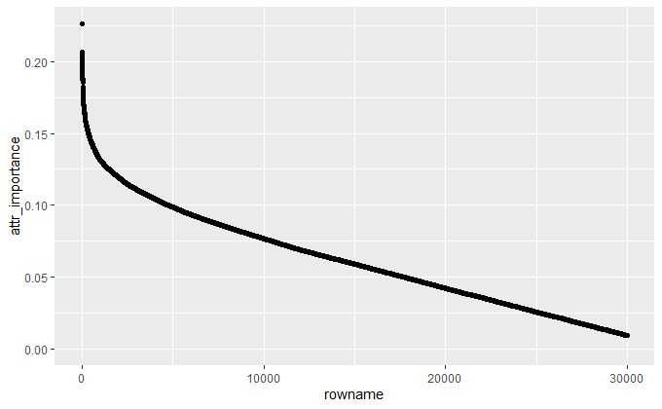
Early attempts = sadness
Univariate filters can still perform poorly if the packages or the user are not so great
Caret is great for exploring, challenging (in my hands) for working with larger data sets
Ended up using Fselector and FESER packages for univariate filtering, as well as PCA and some other stuff….

Slide 4
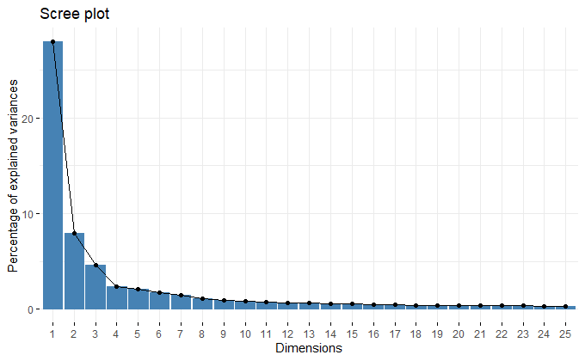
Dimension reduction and feature selection
PCA, univariate filters all showed expected rapid drop off in feature importance
However, no very strong predictors emerged, which surprised me.

Slide 5
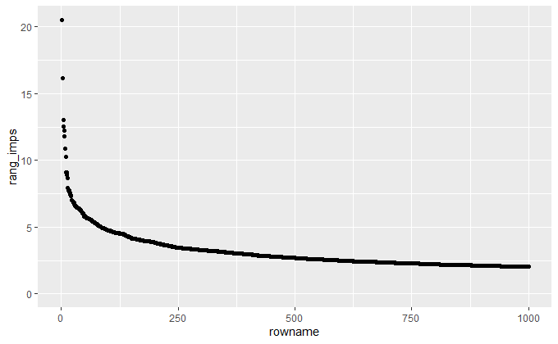
Feature Selection
Simple correlations worked well for regression models
Random forest feature selection ultimately worked the best

Slide 6
Exploring simple models
Univariate filtration used on numerous basic models. Some impressively bad
The more variables you feed to a simple regression algorithm, the more aggressively you overfit, making for frankly amusing validation failures.
Filtration Method | Number of Variables | RMSE on validation
Correlation | 100 | 7.14
Correlation | 500 | 260
Correlation | 4800 | 3704
Inf. Gain | 10 | 8.16
PCA | 5 | 8.18
PCA | 25 | 7.44
PCA | 100 | 11.45

Slide 7
More interesting models
Wrappers or “embedded” regularization?
Computational problems
Large set of features, dumb analyst.
Unable to to get most embedded or wrapper functions to work on datasets
Fed them univariate filtrates
Model Type | Filter Type | Number of Variables | RMSE on validation
SVM(radial) | Correlation | 100 | 6.0
SVM(radial) | Correlation | 1000 | 5.90!
SVM (linear) | Correlation | 4800 | 6.43
RF | Correlation | 100 | 6.44
RF | Correlation | 500 | 7.75
RF | Correlation | 4300 | 7.8

Slide 8
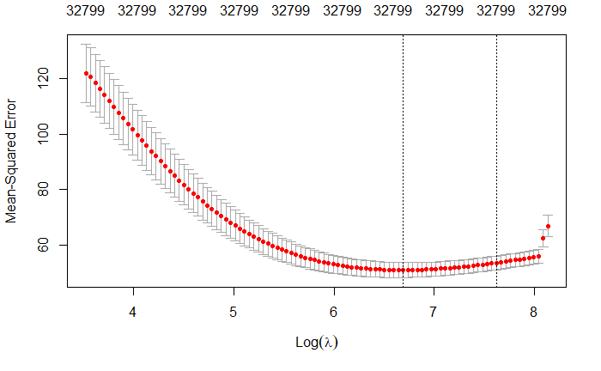
Embedded Regularization
Use of some better packages (glmnet) and abandonment of caret allowed me to deploy some models with embedded feature selection
Elasticnet (ridge+lasso, sparse pca), Ranger(random forest)
Results were ….
…meh

Slide 9
Algorithms still performed better on filtered data
RF feature selection via feature importance emerged as best method
When combined with regularized regression or SVM performance is relatively good, and much improved over performance on full feature set
Model | Feature Selection | Error Metric | Error Result
Random Forest | None | RMSE | 7.31
Ridge Regression | None RF | RMSE | 7.38 5.67
Lasso | None RF | RMSE | 7.20 5.75
GLM | RF | RMSE | 6.6
SVM (radial) | RF | RMSE | 5.63

Slide 10
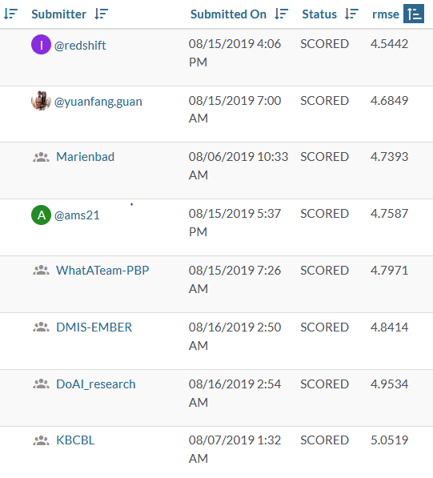
Benchmarking
So this is a challenge
I cheated.
Several strategies were widely pursued
Sort of what I did, but better
Feature selection methods
SPCA
Known Gene Lists
SVD!
Generally ridge regression, sometimes Ensemble regressions
Overall results = not terribly impresive
Winning RMSE=4.54

